Slide 1
Visualization Workshop
Thom Miano
RTI International
Center for Data Science

Slide 2

The Hard Stuff
Part 1 of 2

Slide 3
Foundations
Physical Media | Play | Color Theory | Space

Slide 4
Use Physical Media
Pen (Ink)
Permanent
Adapt to what exists and incorporate it.
Charcoal & Pencil
Variable
Can be removed, blended, and faded.
Exercises for flow:
Draw without picking up your pen
Keep your movement constant (i.e., try not to stop until you’re done)
Play!
Source: https://en.wikipedia.org/wiki/RGB_color_model

Slide 5
Play! (i.e., be a child)
Don’t ever denigrate yourself or your own drawing abilities.
Be conscious of how you talk to your[self] child about the art you she makes.
Make art fun and exploratory.
Keep your art activities appropriate for your her age and developmental stage.
Source: http://artfulparent.com/2012/07/how-to-encourage-drawing-skills-confidence-creativity-in-young-children.html

Slide 6
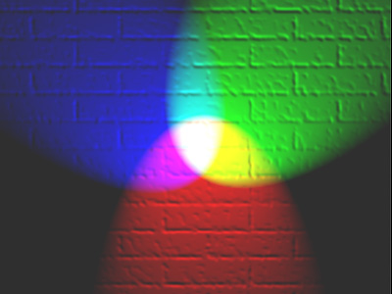
Color Theory – I. RGB Color Model
RGB (Red, Green, Blue) – Additive in the sense that their light spectra add, wavelength for wavelength, to make the final color's spectrum.
Additive color mixing of primary color lights
Blue
Green
Cyan
Magenta
Yellow
Red
Source: https://en.wikipedia.org/wiki/RGB_color_model

Slide 7
Color Theory – I. RGB Color Model
Photograph of Mohammed Alim Khan (1880–1944)
Taken in 1911 by Sergei Mikhailovich Prokudin-Gorskii
Using three exposures with red, green, and blue filters
Source: https://en.wikipedia.org/wiki/RGB_color_model

Slide 8
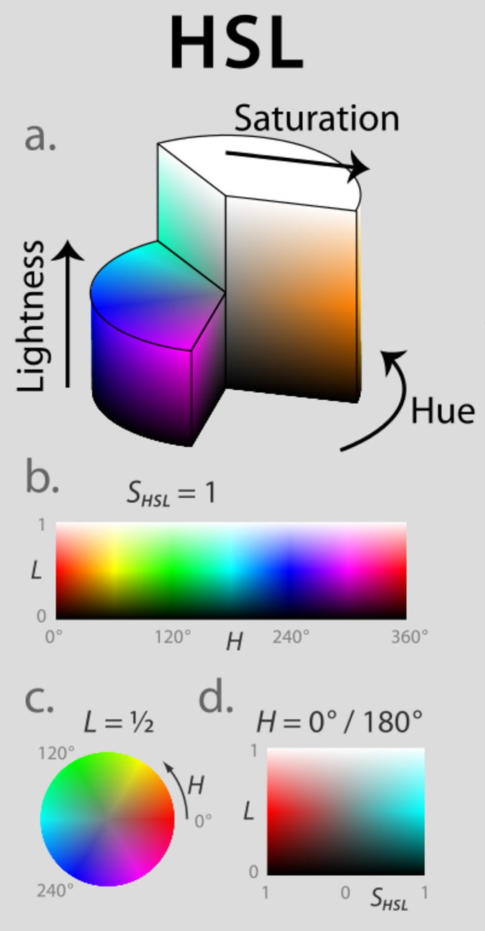
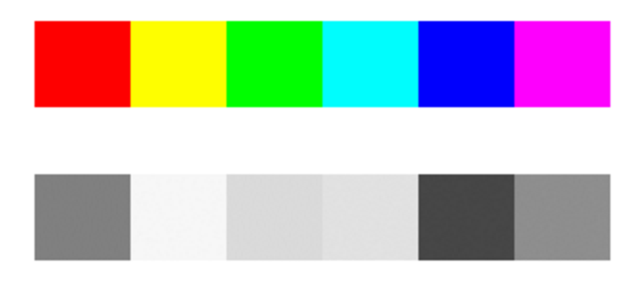
Color Theory – II. Representations of RGB
HSV (Hue, Saturation, Value)
Problems with HSV:
Value is a measure for the physical lightness of color, not the perceived brightness.
6 hues of same value
Greyscale conversion
Source: https://en.wikipedia.org/wiki/HSL_and_HSV

Slide 9
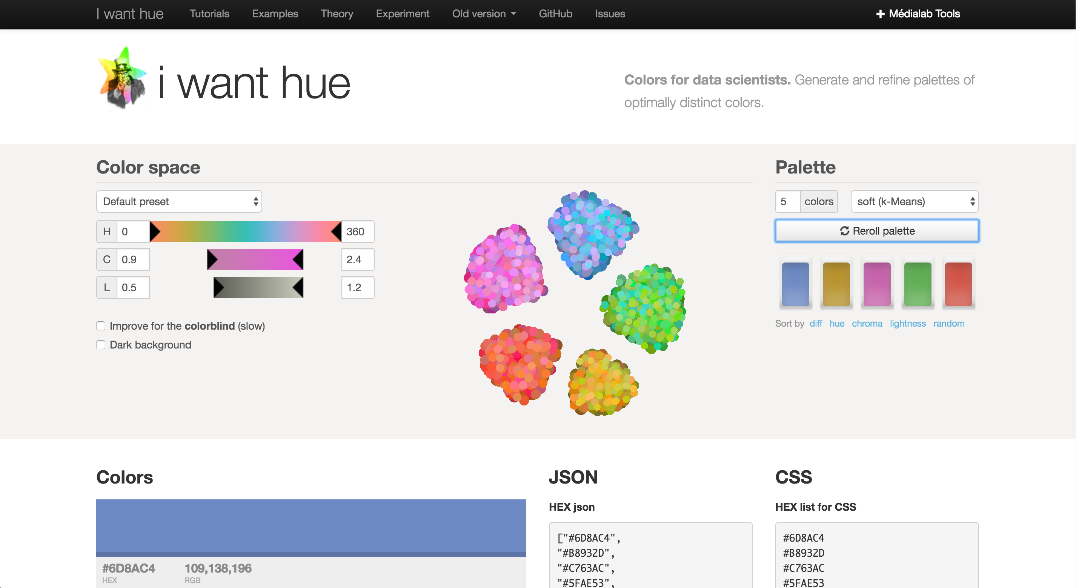
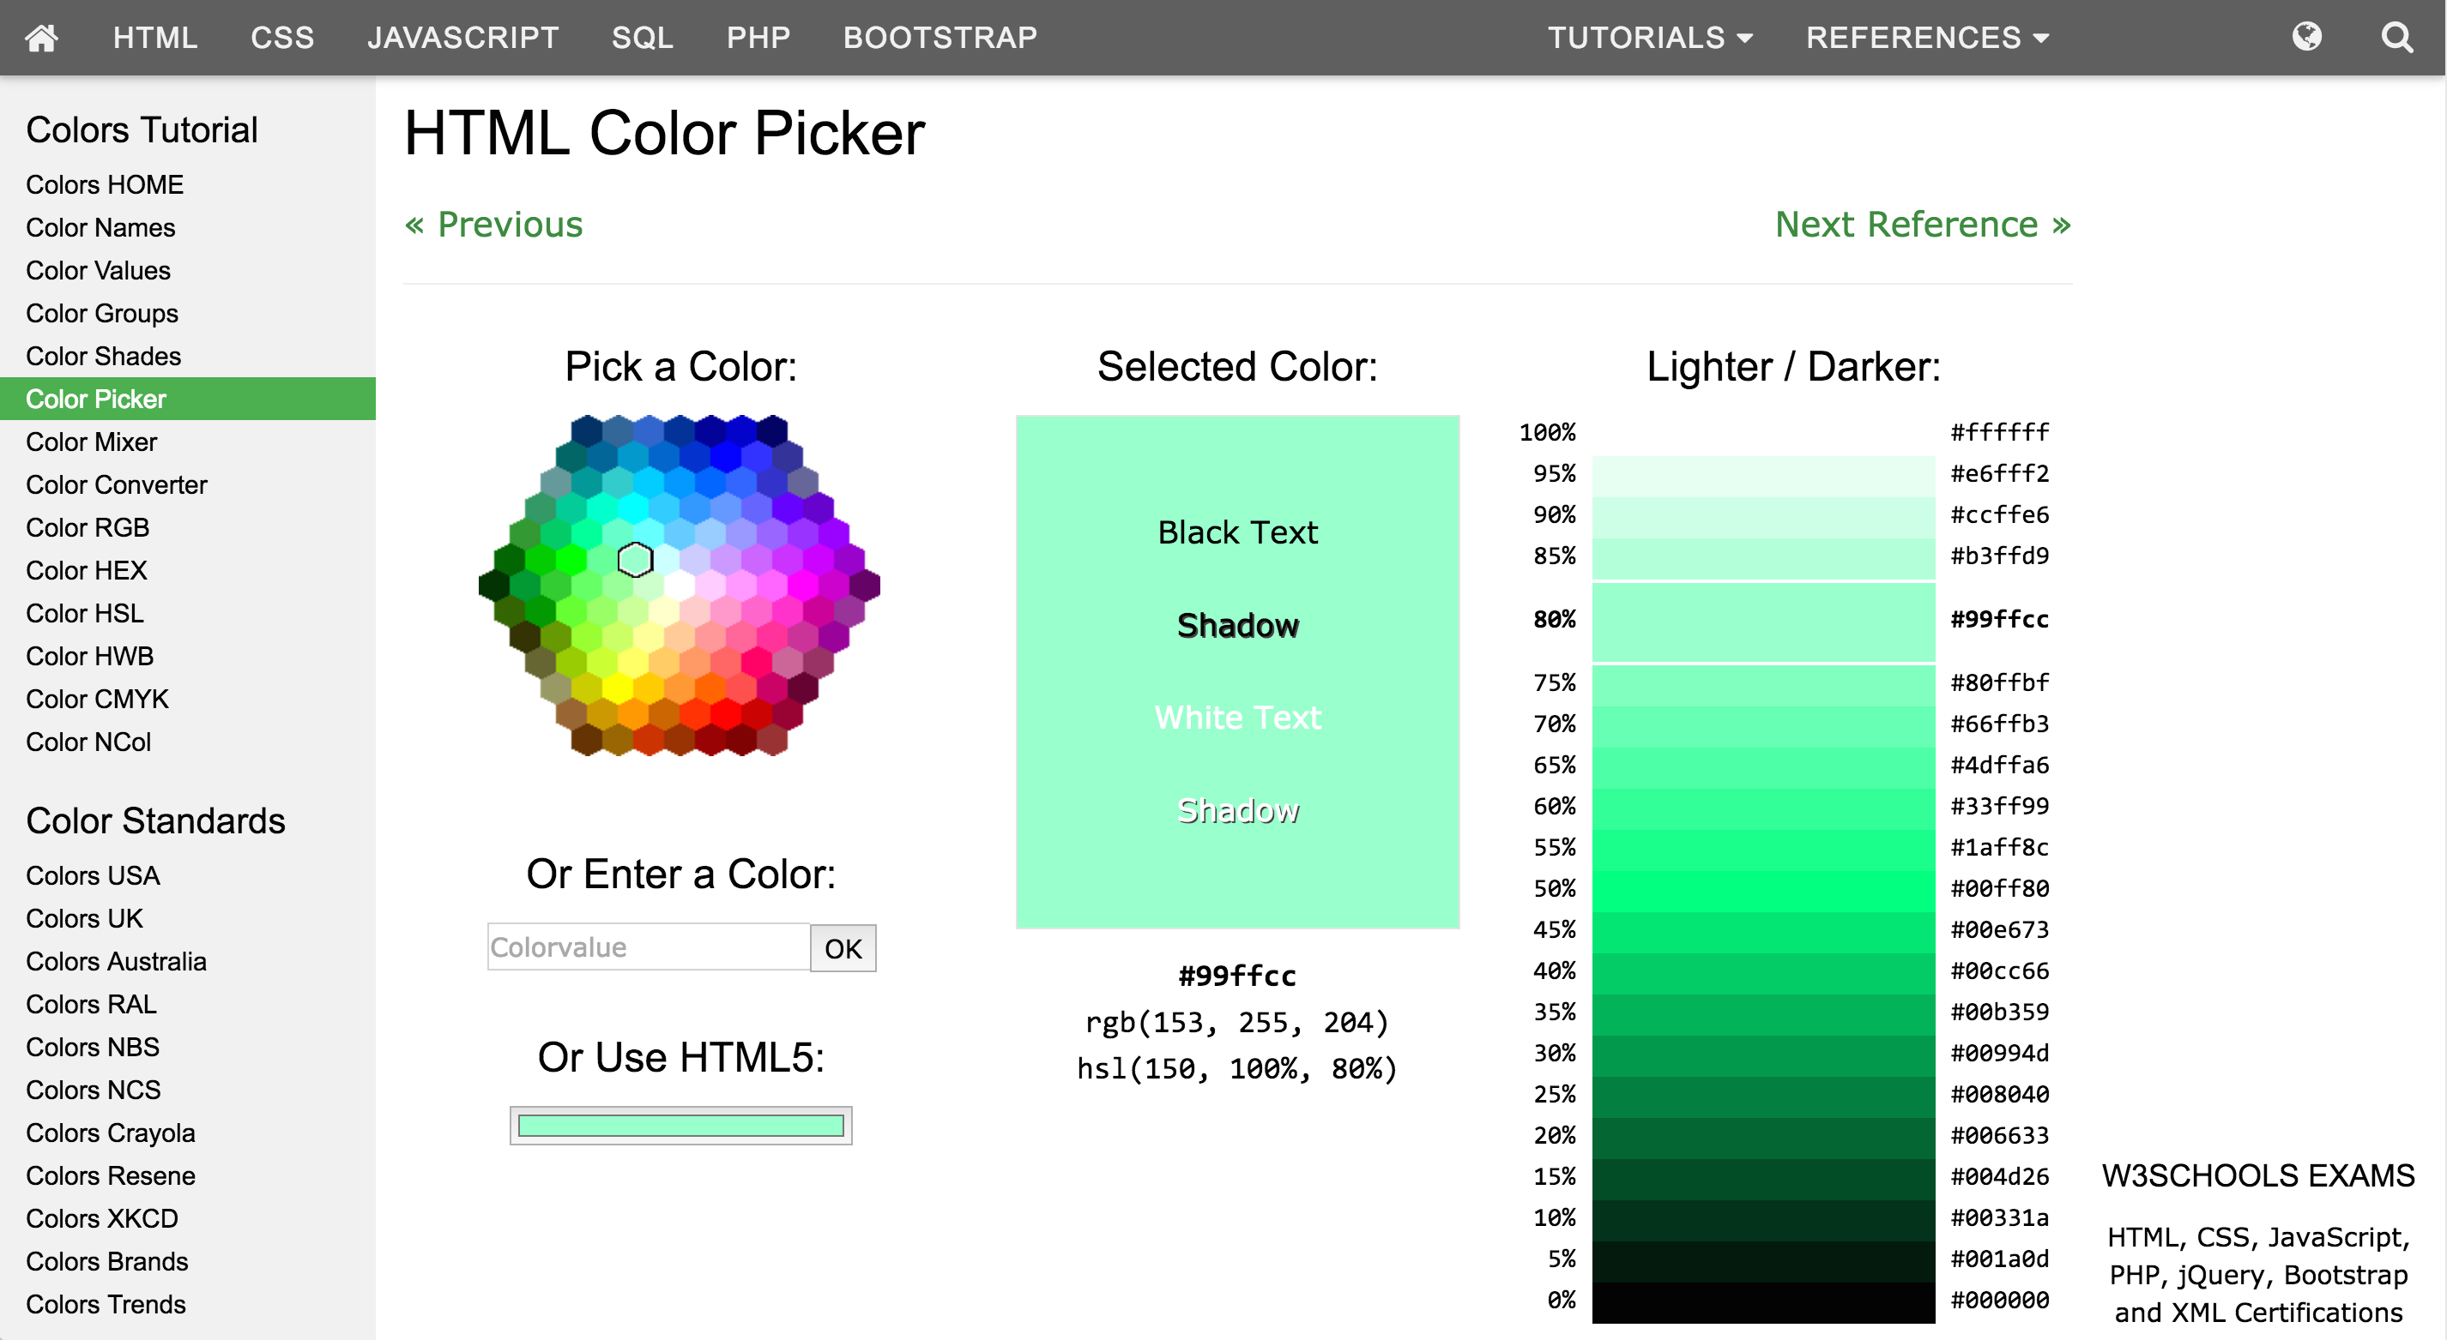
Color Theory – III. Selecting Colors
Overcoming Problems with HSV:
Computers vs Humans
http://vis4.net/blog/posts/avoid-equidistant-hsv-colors/
i want hue – “Colors for data scientists”
Generates algorithmically derived palettes
http://tools.medialab.sciences-po.fr/iwanthue/
w3schools.com
Variety of tools, shows rgb and hex values.
http://www.w3schools.com/colors/colors_picker.asp

Slide 10
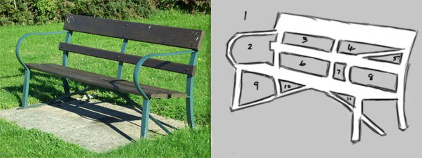
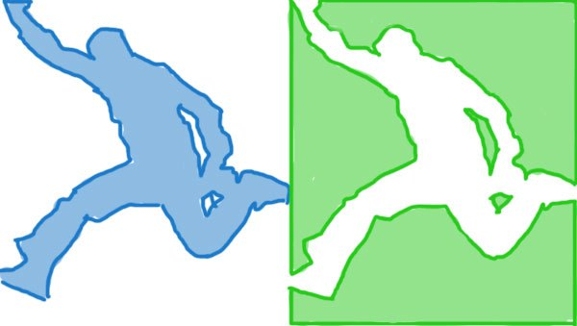
Perception of Spaces – Positive & Negative
Thinking in positive and negative space
Questions to think about:
How do your elements interact with space?
What role is negative space playing in how your visualization is perceived?
Does your final project have dimension specifications for how it will be used?
Are unusual dimensions appropriate?
Source: http://rightbrainrockstar.com/art-instruction/basic-drawing-skills-perception-spaces/

Slide 11
Data
Ethics | Vision | Storytelling | Interpretability

Slide 12
Ethics & Responsibility
Data visualization is inherently biased.
What is shown and what is not shown
Which elements have focus
Human cognition
Spatial understanding (e.g., pie-charts)
Emotional response to design
Colors
Shapes (rounded vs sharp edges)
Pattern recognizing brains

Slide 13
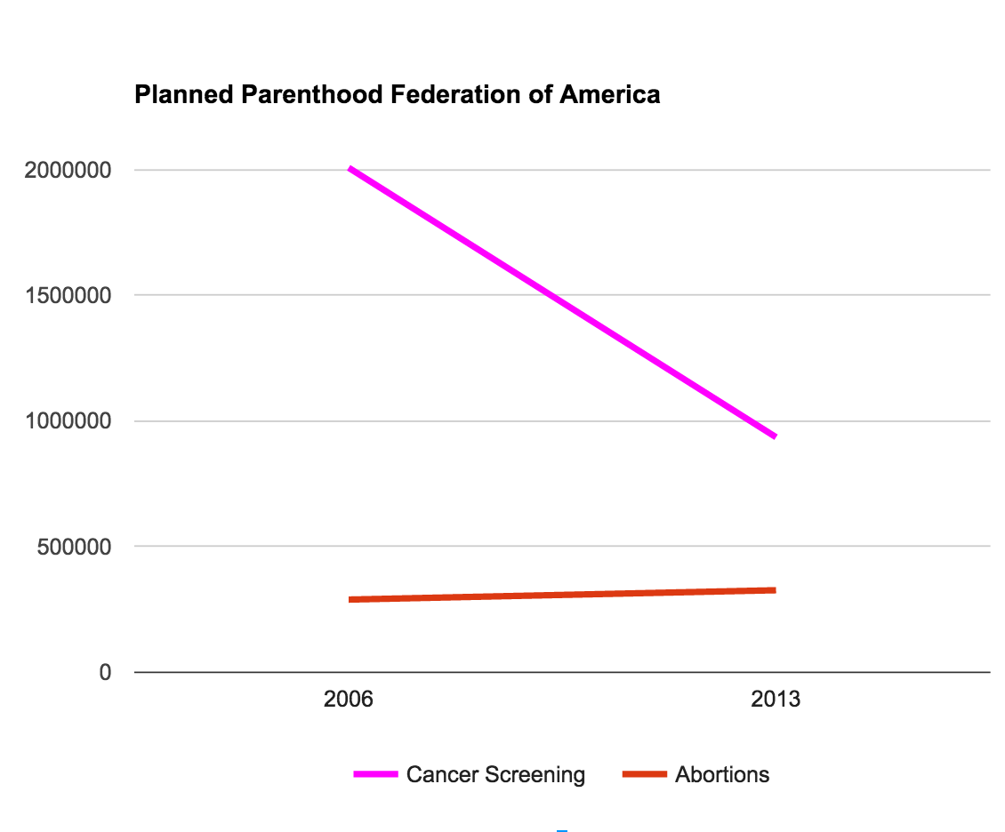
Ethics & Responsibility

Slide 14
Vision
Have a well-defined strategy prior to any coding.
Key Questions:
Timeline & Budget
Context of visualization
Evidence
Exploration
Explanation
Stakeholders/audience
“General public” is a bad answer
Purpose
Platforms
Static vs dynamic
Journal vs presentation
Chrome vs Firefox vs IE

Slide 15
Storytelling
Effective visualizations tell stories.
Context
Attention focused and directed
Underlying value in information (often including a narrative)
Clarity and accessibility
Knowledge transfer

Slide 16
Interpretability
Information / Comprehension Equilibrium
Every design element is a datum
Complex ideas do not necessitate complex visualizations
Extraneous information is noise and confuses the user

Slide 17

The Easy Stuff
Part 2 of 2

Slide 18
Coding for the Web
WebDev Overview | Exercise with Python, DC.js and Crossfilter

Slide 19
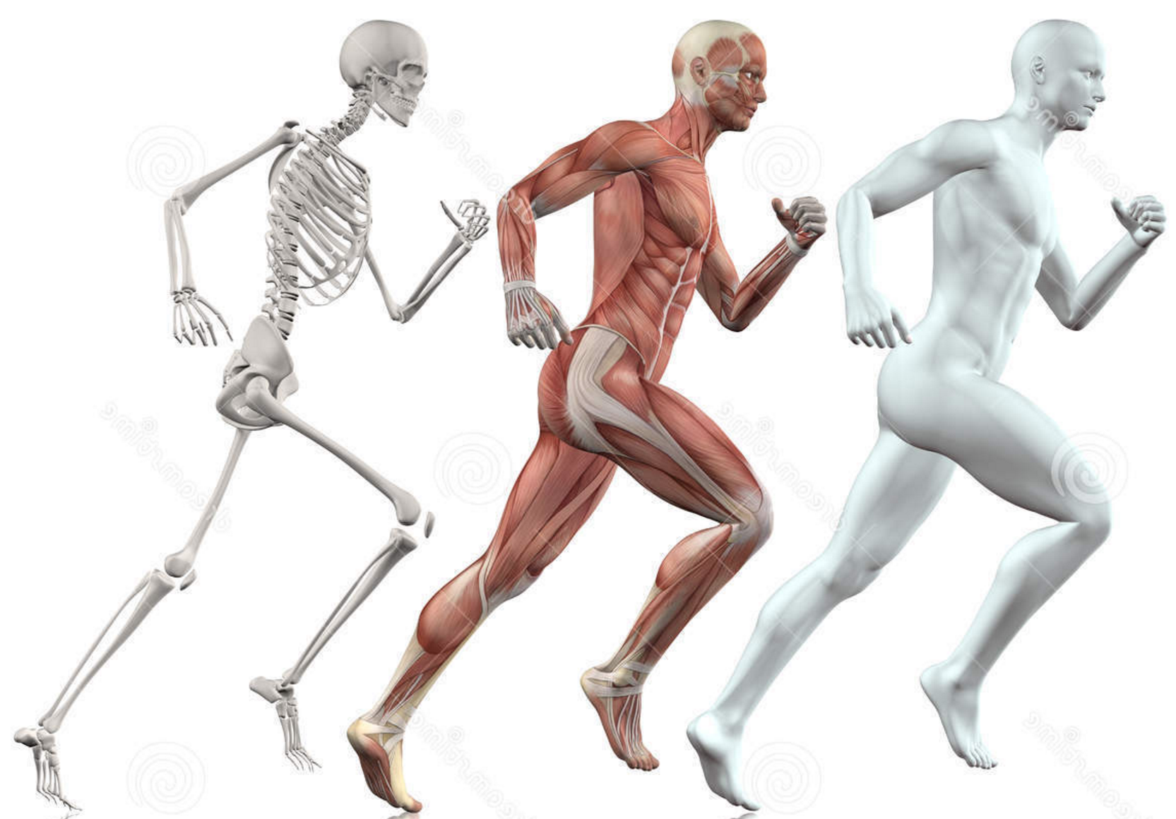
WebDev Overview
HTML
Javascript
CSS
Source: http://thumbs.dreamstime.com/z/male-figure-running-d-skin-skeleton-muscle-map-51689859.jpg

Slide 20

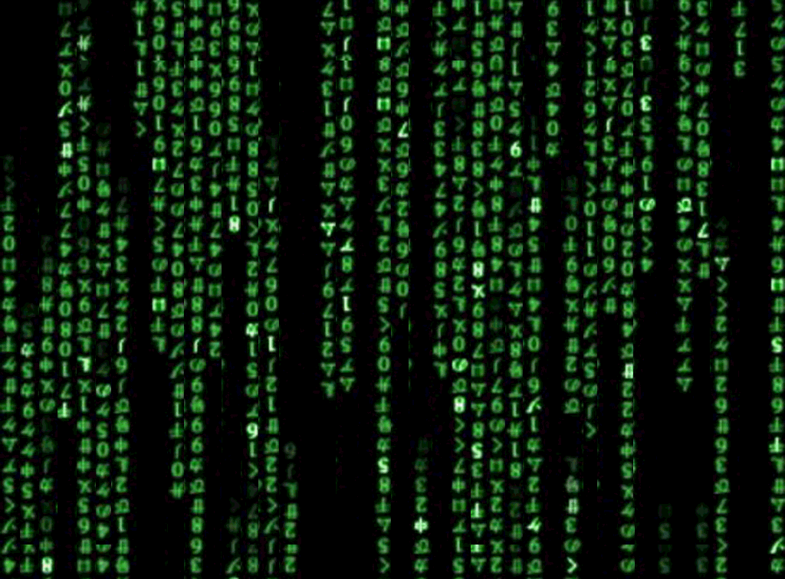
Coding Exercise

Slide 21
Resources
Javascript
Viz exercises from workshop:
https://github.com/thommiano/viz_exercises
d3:
http://chimera.labs.oreilly.com/books/1230000000345/pr01.html
dc + crossfilter:
http://www.codeproject.com/Articles/693841/Making-Dashboards-with-Dc-js-Part-1-Using-Crossfil
http://dc-js.github.io/dc.js/examples/
DataTable.js
https://www.datatables.net/manual/installation
three
http://threejs.org/
Light-weight 3D library. The library provides <canvas>, <svg>, CSS3D and WebGL renderers.
Processing
https://processing.org/
+ p5.js and processing.py
Python
Bokeh
http://bokeh.pydata.org/en/latest/
Udemy MOOCs
Learn Unity by building games: https://www.udemy.com/unitycourse/learn/v4/overview
Complete guide to blender: https://www.udemy.com/blendertutorial/
openFrameworks (C++) [OpenGL]
https://en.wikipedia.org/wiki/OpenFrameworks
SuperCollider
http://supercollider.github.io/
Real-time audio synthesis and algorithmic compositon
Cinder (C++)
https://libcinder.org/gallery
domains like graphics, audio, video, and computational geometry
Events
Eyeo Festival!
http://eyeofestival.com/
The Creative Coding Podcast!!!
http://creativecodingpodcast.com/

